Slide 1
MLSA Data Analysis Project
Comprehensive and advanced analytics reports
Priyanka Behera
CS Branch
2300290120171

Slide 2
Project Overview
Objective:
To leverage Power BI for in-depth sales and customer insights.
Scope:
Analysing customer demographics, sales trends, product, and store performance.

Slide 3
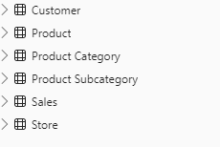
Data Sources
The project uses the following tables:
1. Customers: Customer demographics, including region and segmentation.
2. Products: Product details categorized by type and subcategories.
3. Subproducts: Granular details on product subcategories.
4. Stores: Store details, including geographic information.
5. Sales: Main transactional data for each sale.

Slide 4
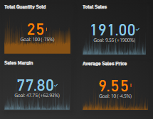
Key Metrics and Calculations
1. Total Sales: Sum of the `Net Price` in Sales data.
2. Total Quantity Sold: Aggregate of product units sold.
3. Average Sales Price: Mean `Net Price` for each product sold.
4. Sales Margin: Calculated as `Net Price - Unit Cost`.
5. Year-over-Year (YoY) Growth: Annual sales growth to track performance trends.

Slide 5

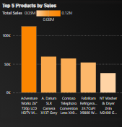
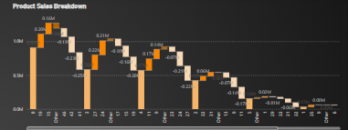
Page 1 - Sales Overview
Sales Trend Analysis: A line chart to show Total Sales over time, identifying seasonal patterns and growth.
Top 5 Products by Sale: The Top 5 Products by Sale column chart highlights our best-selling products based on total sales revenue.
Product Sales Breakdown: The Waterfall Chart of product sales breakdown visually represents how various products contribute to our total sales figures.

Slide 6
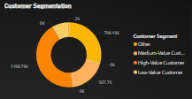
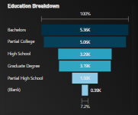
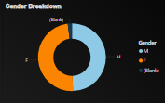
Page 2: Customer Insights
Customer Segmentation: A pie chart categorizing customers into segments (High, Medium, Low Value).
Gender Breakdown: A donut chart visualizing gender distribution among customers.
Education Distribution: A funnel chart showcasing the distribution of education levels among customers.
Geographic Insights: A filled map visualizing Total Sales by location with slicers for filtering by state.

Slide 7
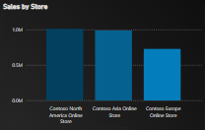
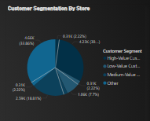
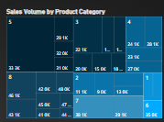
Page 3: Product & Store Analysis
Store Performance: A map indicating sales by store location to highlight regional performance.
Top Performing Products: Multi-row card showing best-selling products per store.
Sales Volume by Product Category: A Treemap detailing product categories that contribute the most to sales.
Customer Segmentation by Store: A pie chart of customer segmentation within each store.

Slide 8
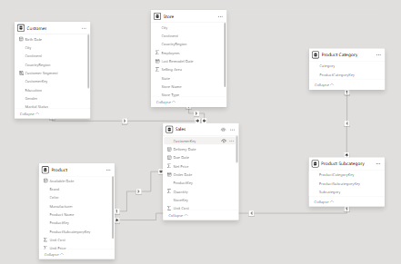

Technical Implementation
Data Modeling:
Created star schema for optimal query performance. Relationships between tables for cohesive analysis.
Custom Visualizations & Tooltips:
Designed tooltips for enhanced user interactivity. Enhanced user experience for actionable insights.
DAX Calculations:
Implemented complex measures for advanced KPIs. Examples of measures used for KPIs.

Slide 9
Conclusion
This Power BI project demonstrates how sales and customer data can be transformed into insightful reports for strategic decision-making. By identifying trends, key customer segments, and product performance, businesses can make more informed choices in sales strategies, product focus, and regional expansion.

Slide 10
Project Repo Link
https://github.com/Priyanka0300/MLSAKIET_DA_INTERNSHIP.git

